Slide 1
ER Model

Slide 2
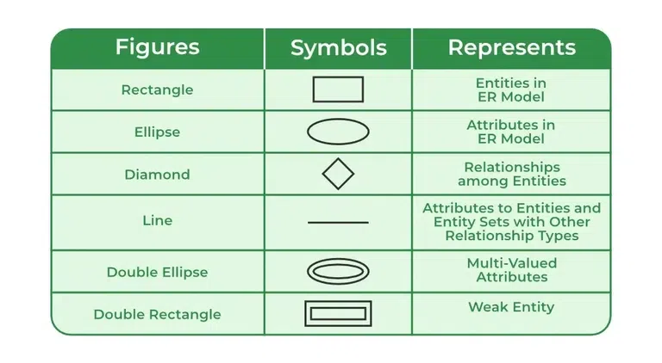
Symbols Used in ER Model

Slide 3
ER Model is used to model the logical view of the system from a data perspective which consists of these symbols:
Rectangles: Rectangles represent Entities in the ER Model.
Ellipses: Ellipses represent Attributes in the ER Model.
Diamond: Diamonds represent Relationships among Entities.
Lines: Lines represent attributes to entities and entity sets with other relationship types.
Double Ellipse: Double Ellipses represent Multi-Valued Attributes.
Double Rectangle: Double Rectangle represents a Weak Entity.

Slide 4
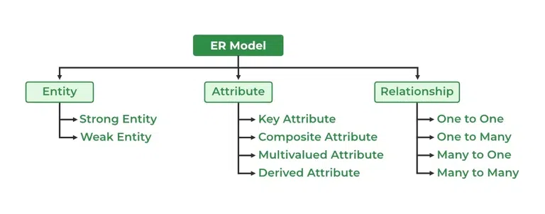
Components of ER Diagram
ER Model consists of Entities, Attributes, and Relationships among Entities in a Database System.

Slide 5
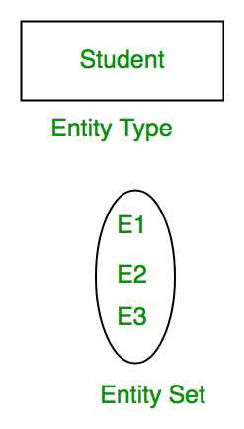
What is Entity?
An Entity may be an object with a physical existence – a particular person, car, house, or employee – or it may be an object with a conceptual existence – a company, a job, or a university course.
What is Entity Set?
An Entity is an object of Entity Type and a set of all entities is called an entity set. For Example, E1 is an entity having Entity Type Student and the set of all students is called Entity Set. In ER diagram, Entity Type is represented as:

Slide 6
Types of Entity
There are two types of entity:
1. Strong Entity
A Strong Entity is a type of entity that has a key Attribute. Strong Entity does not depend on other Entity in the Schema. It has a primary key, that helps in identifying it uniquely, and it is represented by a rectangle. These are called Strong Entity Types.
2. Weak Entity
An Entity type has a key attribute that uniquely identifies each entity in the entity set. But some entity type exists for which key attributes can’t be defined. These are called Weak Entity types .

Slide 7
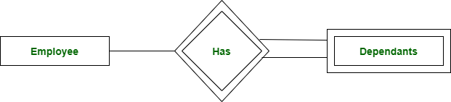
A weak entity type is represented by a Double Rectangle. The participation of weak entity types is always total. The relationship between the weak entity type and its identifying strong entity type is called identifying relationship and it is represented by a double diamond.

Slide 8
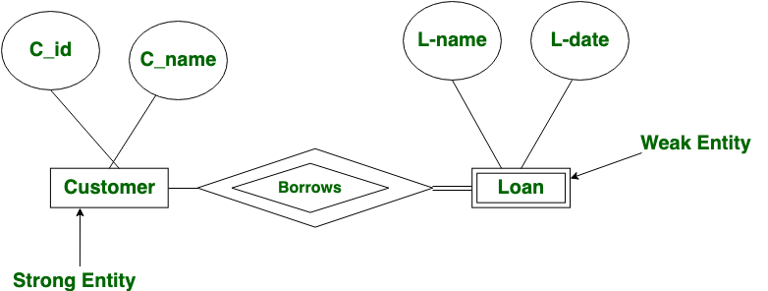
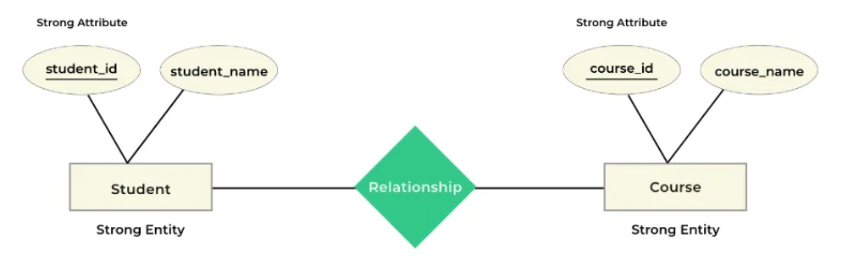

Slide 9
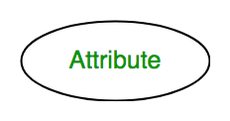
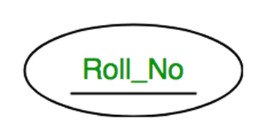
What is Attributes?
Attributes are the properties that define the entity type. For example, Roll_No, Name, DOB, Age, Address, and Mobile_No are the attributes that define entity type Student. In ER diagram, the attribute is represented by an oval.
Types of Attributes
1. Key Attribute
The attribute which uniquely identifies each entity in the entity set is called the key attribute. For example, Roll_No will be unique for each student. In ER diagram, the key attribute is represented by an oval with underlying lines.

Slide 10
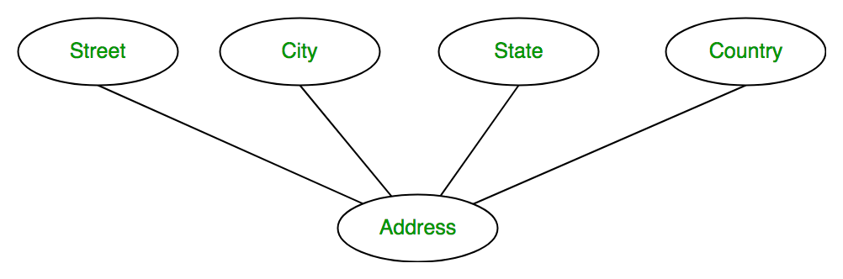
2. Composite Attribute
An attribute composed of many other attributes is called a composite attribute. For example, the Address attribute of the student Entity type consists of Street, City, State, and Country. In ER diagram, the composite attribute is represented by an oval comprising of ovals.

Slide 11
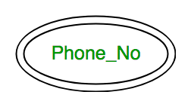
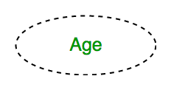
3. Multivalued Attribute
An attribute consisting of more than one value for a given entity. For example, Phone_No (can be more than one for a given student). In ER diagram, a multivalued attribute is represented by a double oval.
4. Derived Attribute
An attribute that can be derived from other attributes of the entity type is known as a derived attribute. e.g.; Age (can be derived from DOB). In ER diagram, the derived attribute is represented by a dashed oval.

Slide 12
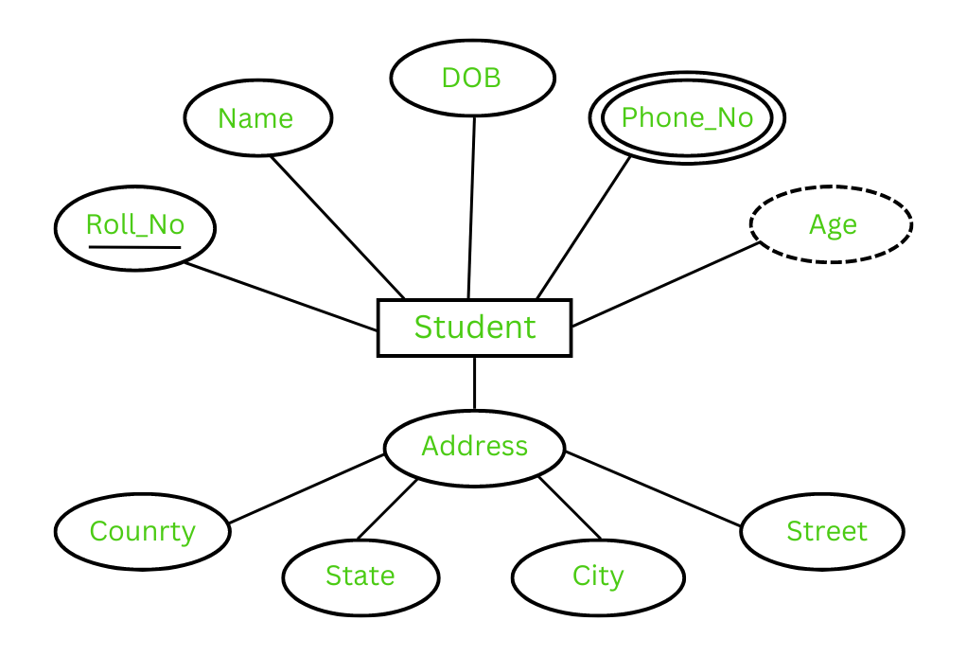
The Complete Entity Type Student with its Attributes can be represented as:

Slide 13
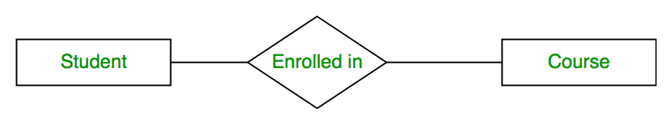
Relationship Type and Relationship Set
A Relationship Type represents the association between entity types. For example, ‘Enrolled in’ is a relationship type that exists between entity type Student and Course. In ER diagram, the relationship type is represented by a diamond and connecting the entities with lines.
A set of relationships of the same type is known as a relationship set.

Slide 14
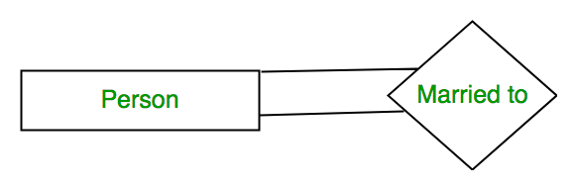
Degree of a Relationship Set
The number of different entity sets participating in a relationship set is called the degree of a relationship set.
Unary Relationship:
When there is only ONE entity set participating in a relation, the relationship is called a unary relationship. For example, one person is married to only one person.

Slide 15
2. Binary Relationship: When there are TWO entities set participating in a relationship, the relationship is called a binary relationship. For example, a Student is enrolled in a Course.
3. Ternary Relationship: When there are three entity sets participating in a relationship, the relationship is called a ternary relationship.
4. N-ary Relationship: When there are n entities set participating in a relationship, the relationship is called an n-ary relationship.

Slide 16
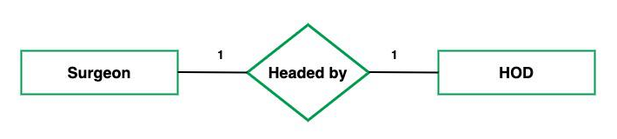
What is Cardinality?
The number of times an entity of an entity set participates in a relationship set is known as cardinality . Cardinality can be of different types:
One-to-One:
When each entity in each entity set can take part only once in the relationship, the cardinality is one-to-one. Let us assume that a male can marry one female and a female can marry one male. So the relationship will be one-to-one. Total number of tables that can be used in this is 2.

Slide 17
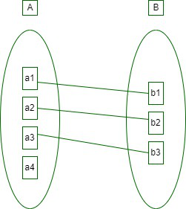
Using Sets, it can be represented as:

Slide 18
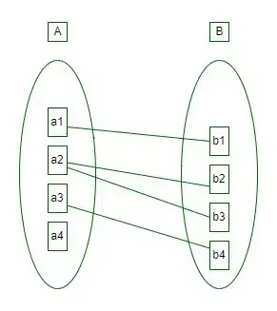
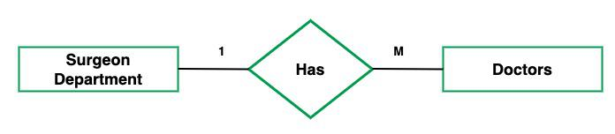
2. One-to-Many: In one-to-many mapping as well where each entity can be related to more than one entity and the total number of tables that can be used in this is 2. Let us assume that one surgeon department can accommodate many doctors. So the Cardinality will be 1 to M. It means one department has many Doctors. Total number of tables that can used is 3.

Slide 19
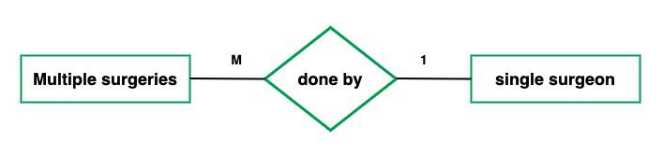
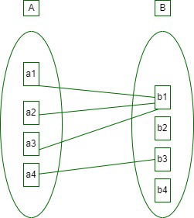
3. Many-to-One: When entities in one entity set can take part only once in the relationship set and entities in other entity sets can take part more than once in the relationship set, cardinality is many to one. Let us assume that a student can take only one course but one course can be taken by many students. So the cardinality will be n to 1. It means that for one course there can be n students but for one student, there will be only one course.

Slide 20
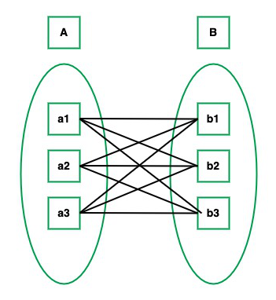
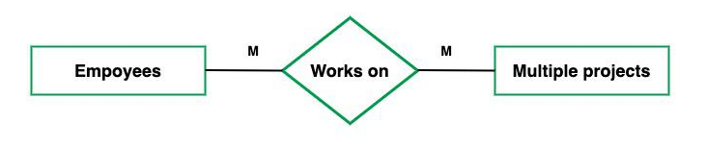
4. Many-to-Many: When entities in all entity sets can take part more than once in the relationship cardinality is many to many. Let us assume that a student can take more than one course and one course can be taken by many students. So the relationship will be many to many.

Slide 21
Participation Constraint
Participation Constraint is applied to the entity participating in the relationship set.
1. Total Participation – Each entity in the entity set must participate in the relationship. If each student must enroll in a course, the participation of students will be total. Total participation is shown by a double line in the ER diagram.
2. Partial Participation – The entity in the entity set may or may NOT participate in the relationship. If some courses are not enrolled by any of the students, the participation in the course will be partial.

Slide 22
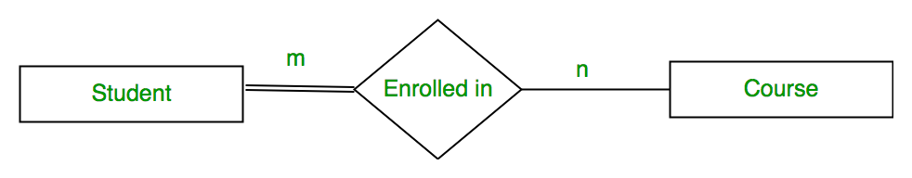
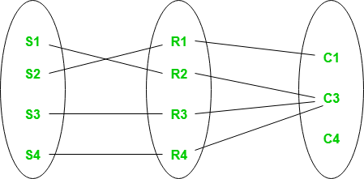
Set representation of Total Participation and Partial Participation

Slide 23
Database Keys
Why do we require Keys in a DBMS?
We require keys in a DBMS to ensure that data is organized, accurate, and easily accessible.
Keys help to uniquely identify records in a table, which prevents duplication and ensures data integrity.
Keys also establish relationships between different tables, allowing for efficient querying and management of data.
Without keys, it would be difficult to retrieve or update specific.

Slide 24
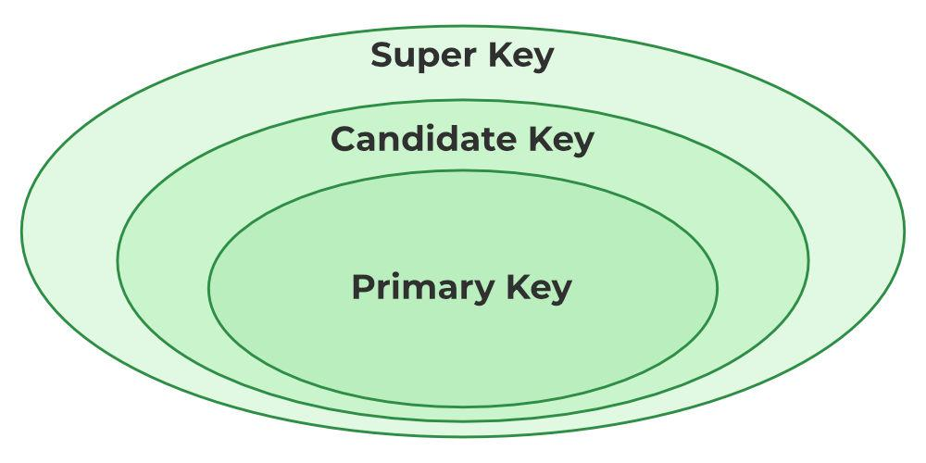
What are the different types of Keys in DBMS?
Candidate Key
Primary Key
Foreign Key
Super Key
Alternate Key
Secondary Key

Slide 25
1. Primary Key
The primary key refers to a column or a set of columns of a table that helps us identify all the records uniquely present in that table.
A table can consist of just one primary key.
It must have unique values and cannot contain any duplicate values.
All primary key values have to be different, and there should be no repetitions.
A primary key cannot be NULL, as it needs to provide a valid, unique identifier for every record.
Any table can consist of only a single primary key constraint

Slide 26
2. Candidate Key
The minimal set of attributes that can uniquely identify a tuple is known as a candidate key.
A candidate key is a minimal super key, meaning it can uniquely identify a record but contains no extra attributes.
It is a super key with no repeated data is called a candidate key.
The minimal set of attributes that can uniquely identify a record.
A candidate key must contain unique values, ensuring that no two rows have the same value in the candidate key’s columns.
Every table must have at least a single candidate key.
A table can have multiple candidate keys but only one primary key.

Slide 27
3. Alternate Key
An alternate key is any candidate key in a table that is not chosen as the primary key.
In other words, all the keys that are not selected as the primary key are considered alternate keys.
An alternate key is also referred to as a secondary key because it can uniquely identify records in a table, just like the primary key.

Slide 28
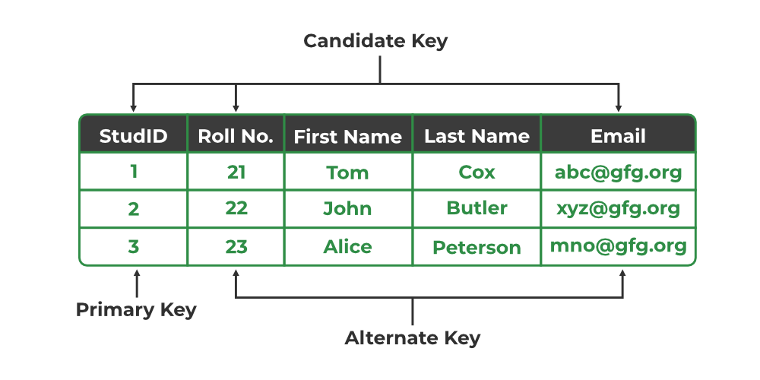

Slide 29
4. Super Key
The set of one or more attributes (columns) that can uniquely identify a tuple (record) is known as Super Key.
A super key is a candidate key’s superset.
A super key is a group of single or multiple keys that uniquely identifies rows in a table. It supports NULL values in rows.

Slide 30
5. Foreign Key
A foreign key is an attribute in one table that refers to the primary key in another table.
The table that contains the foreign key is called the referencing table, and the table that is referenced is called the referenced table.
A foreign key in one table points to the primary key in another table, establishing a relationship between them.
It helps connect two or more tables, enabling you to create relationships between them. This is essential for maintaining data integrity and preventing data redundancy.
They act as a cross-reference between the tables.

Slide 31
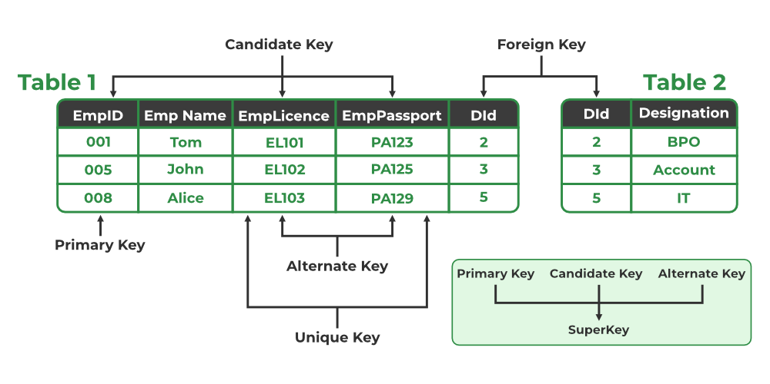

Slide 32
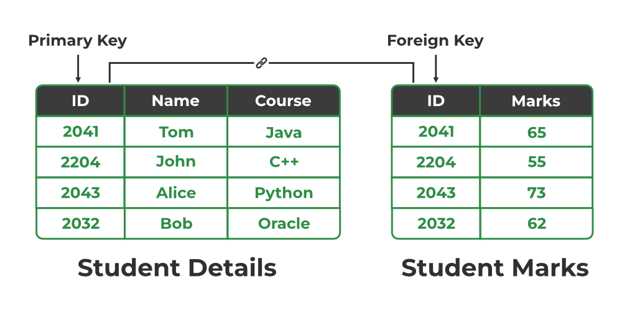

Slide 33
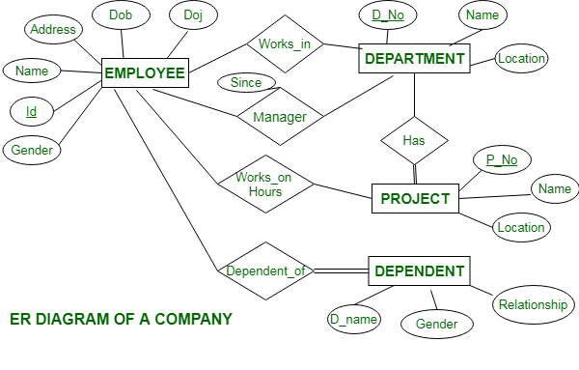
Example 1:
Company has several departments. Departments are identified by a name, d_no, Location. Each department may have several Locations. Employees are identified by name, id, address, job, date_of_joining. An employee works in only one department but can work on several project. Each employee has a dependent. Dependent has D_name, Gender, and relationship. Each department is associated with number of projects. A Manager control a particular department. We also keep track of number of hours worked by an employee on a single project.

Slide 34
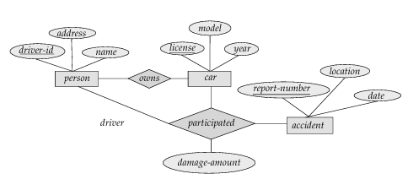
Example 2:
Construct an E-R diagram for a car-insurance company whose customers own one or more cars each. Each car has associated with it zero to any number of recorded accidents.

Slide 35
Integrity Constraints
Integrity constraints are a set of rules used in DBMS to ensure that the data in a database is accurate, consistent and reliable.
These rules helps in maintaining the quality of data by ensuring that the processes like adding, updating or deleting information do not harm the integrity of the database.
In simple terms, they act as guidelines to protect the database and keep it error-free.
Integrity constraints also define how different parts of the database are connected and ensure that these relationships remain valid.

Slide 36
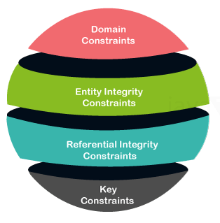

Slide 37
Domain Constraints
Domain constraints are a type of integrity constraint that ensure the values stored in a column (or attribute) are valid and within a specific range or domain.
In simple terms, they define what type of data is allowed in a column and restrict invalid data entry.
The data type of domain include string, char, time, integer, date, currency etc.
Eg. If we assign the datatype of attribute age as int, we can’t give it values other than int datatype.

Slide 38
Key constraints
Keys are the entity set that is used to identify an entity within its entity set uniquely.
A relation can have multiple keys or candidate keys(minimal superkey), out of which we choose one of the keys as the primary key, we don’t have any restriction on choosing the primary key out of candidate keys.
An entity set can have multiple keys, but out of which one key will be the primary key. A primary key must be unique and cannot be NULL in the relational table.

Slide 39
Entity Integrity Constraints
Entity integrity constraints state that primary key can never contain null value because primary key is used to determine individual rows in a relation uniquely, if primary key contains null value then we cannot identify those rows.
A table can contain null value in it except primary key field.
The primary key value must be unique for each row in the table.
No duplicate entries are allowed in the primary key column.
NOT NULL
The primary key column cannot contain NULL values, as every row must have a valid identifier.

Slide 40
Referential integrity
Referential integrity refers to the relationship between tables.
A referential integrity constraint is also known as foreign key constraint. A foreign key is a key whose values are derived from the Primary key of another table.
The table from which the values are derived is known as Master or Referenced Table and the Table in which values are inserted accordingly is known as Child or Referencing Table, In other words, we can say that the table containing the foreign key is called the child table, and the table containing the Primary key/candidate key is called the referenced or parent table.

Slide 41
Extended ER Features
The Extended Entity-Relationship (EER) model is an enhancement of the basic Entity-Relationship (ER) model used in database design. It includes additional features that provide more detail and allow for a more accurate representation of complex real-world scenarios.
Using the ER model for bigger data creates a lot of complexity while designing a database model, So in order to minimize the complexity Generalization, Specialization, and Aggregation were introduced in the ER model.
These were used for data abstraction. In which an abstraction mechanism is used to hide details of a set of objects.

Slide 42
1. Generalization
Generalization is the process of extracting common properties from a set of entities and create a generalized entity from it.
Generalization is a "bottle-up approach" in which two or more entities can be combined to form a higher level entity if they have some attributes in common.
Subclasses are combined to make a superclass.
Generalization is used to emphasize the similarities among lower-level entity set and to hide differences in the schema.

Slide 43
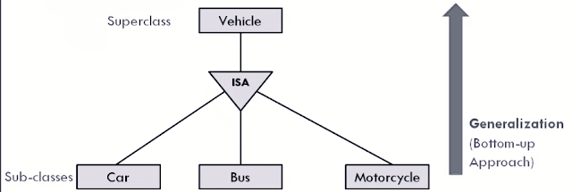

Slide 44
2. Specialization
Specialization is opposite of Generalization.
In Specialization, an entity is broken down into sub-entities based on their characteristics.
Specialization is a "Top-down approach" where higher level entity is specialized into two or more lower level entities.
Specialization is used to identify the subset of an entity set that shares some distinguishing characteristics
Specialization can be repeatedly applied to refine the design of schema.
Normally, the superclass is defined first, the subclass and its related attributes are defined next, and relationship set are then added.
Depicted by triangle component labeled ISA

Slide 45
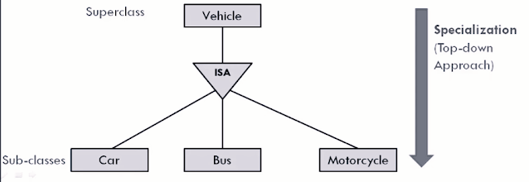

Slide 46
3. Aggregation
Aggregation is used when we need to express a relationship among relationships.
Aggregation is an abstraction through which relationships are treated as higher level entities.
Aggregation is a process when a relationship between two entities is considered as a single entity and again this single entity has a relationship with another entity.

Slide 47
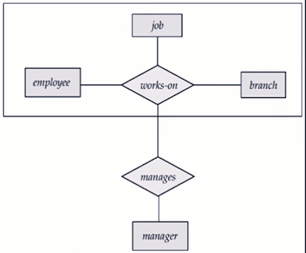
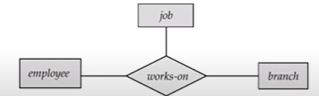

Slide 48
Constraints on the generalization, specialization and aggregation
There are three constraints that may apply to a specialization/generalization: membership constraints, disjoint constraints and completeness constraints.
The first is the disjointness (or disjointedness) constraint, which specifies that the subclasses of the specialization must be disjoint.
If the subclasses are not constrained to be dis-joint, their sets of entities may be overlapping;

Slide 49
The second constraint on specialization is called the completeness (or totalness) constraint, which may be total or partial. A total specialization constraint specifies that every entity in the superclass must be a member of at least one subclass in the specialization.
Membership in such a subclass is determined by the database users when they apply the operation to add an entity to the subclass; hence, membership is specified individually for each entity by the user, not by any condition that may be evaluated automatically.

